Slide 1

BDM CAPSTONE PROJECT MAY TERM, 2026
STRATEGIC WORKFORCE PLANNING AND INVENTORY OPTIMIZATION
NAME: ARPIT KUMAR MISHRA
ROLL NO: 25F1002120
IITM ONLINE BS DEGREE PROGRAM

Slide 2
BUSINESS CONTEXT & KEY PROBLEMS
BUSINESS CONTEXT
ASHMITI ENTERPRISE IS A VADODARA BASED B2B ORGANIZATION (FOUNDED BY MR. RAMNATH MISHRA) PROVIDING PRINTER MANAGEMENT, TONER CARTRIDGE REMANUFACTURING, IT INFRASTRUCTURE MAINTENANCE, EQUIPMENT RENTALS AND ANNUAL MAINTENANCE CONTRACTS(AMC) SERVICES ACROSS MULTIPLE INDIAN STATES.
01
INVENTORY & PROCUREMENT
CAPITAL CONCENTRATION
PROCUREMENT FLUCTUATIONS
INVENTORY PRIORITIZATION
WORKING-CAPITAL UTILIZATION
02
WORKFORCE & SERVICE
WORKFORCE AVAILABILITY
SLA COMPLIANCE
SERVICE QUALITY
REPEAT VISITS & COMPLAINTS

Slide 3
DATA & ANALYTICAL APPROACH
01 | DATA SOURCES
Business records - Ashmiti Enterprise
Tally ERP
Purchase Register
Credit Transaction Register
Godown Summary
Operational records
Workforce attendance
Service visits
02 | DATA USED
193 Inventory categories
936 Employee-day records
360 Service visits
12 employees | Apr-Jun 2026
6 months - Purchase & credit records
Jan–Jun 2026
03 | ANALYTICAL APPROACH
INVENTORY & PROCUREMENT
Descriptive Statistics
Procurement trend & variability
Inventory concentration
ABC classification
WORKFORCE & SERVICE
Attendance analysis
SLA performance
Service quality
Repeat visits and complaints

Slide 4
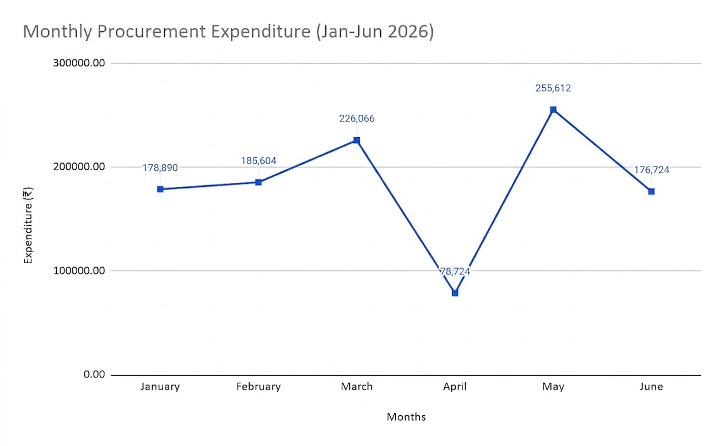
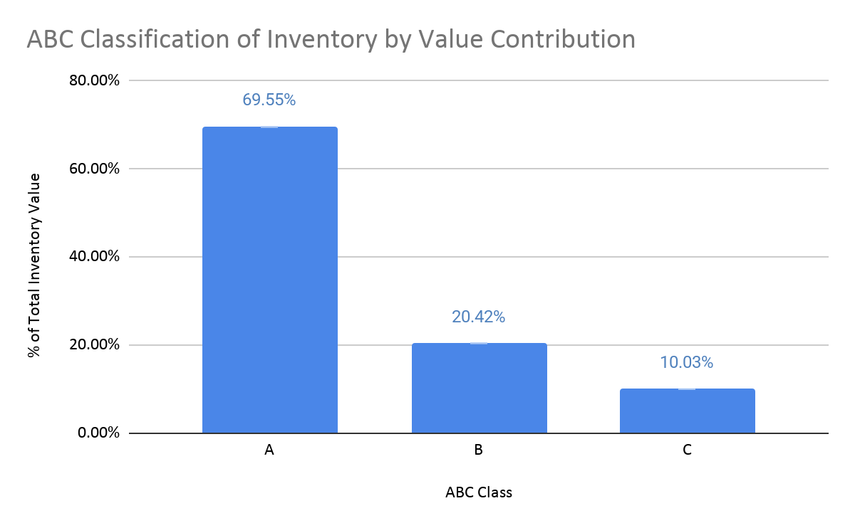
INVENTORY & PROCUREMENT: KEY FINDINGS
01 | PROCUREMENT TREND
32.73% CV Substantial month-to-month variation
02 | INVENTORY CONCENTRATION
69.55% of value held in A-class categories

Slide 5
INVENTORY & PROCUREMENT: BUSINESS IMPLICATIONS
FINDING
69.55% of value in A-class categories
IMPLICATION
Capital is concentrated in few categories
ACTION
Prioritise A-class inventory for frequent review
FINDING
Procurement CV = 32.73%
IMPLICATION
Purchasing needs closer planning
ACTION
Monthly procurement reviews using inventory needs, past spending & ABC
ABC analysis is value-based; adding consumption/stock velocity would improve identification of slow-moving or obsolete inventory.

Slide 6
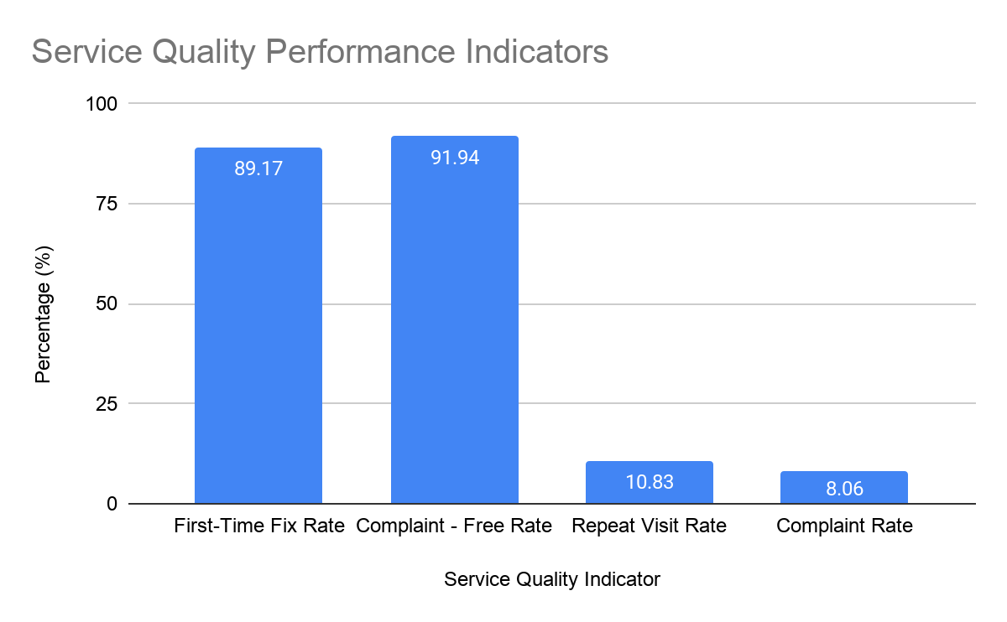
WORKFORCE & SERVICE: KEY FINDINGS
02 | SERVICE QUALITY
4.42/5 AVERAGE CUSTOMER RATING
01 | WORKFORCE & SLA
93.59 %
SLA - Present
45.83%
SLA - Absent, Unplanned
Unplanned absence was associated with substantially lower SLA compliance.
Descriptive association; causality not established.
KEY TAKEAWAY
Service quality was generally satisfactory, but unplanned workforce absence coincided with weaker SLA performance. Skill compatibility and geographic routing should also be considered in workforce planning.

Slide 7
WORKFORCE & SERVICE: BUSINESS IMPLICATIONS
FINDING
45.83% SLA compliance during unplanned absence
IMPLICATION
Unexpected workforce shortages can affect service commitments.
ACTION
Maintain backup personnel and prioritize critical service visits.
FINDING
10.83% repeat visits
8.06% complaints
IMPLICATION
Some cases require additional service effort
ACTION
Record repeat-visit reasons and improve diagnosis, parts & allocation
SERVICE QUALITY CONTROL
Categorise complaints and repeat visits by service type and machine model to identify recurring high-impact issues.

Slide 8
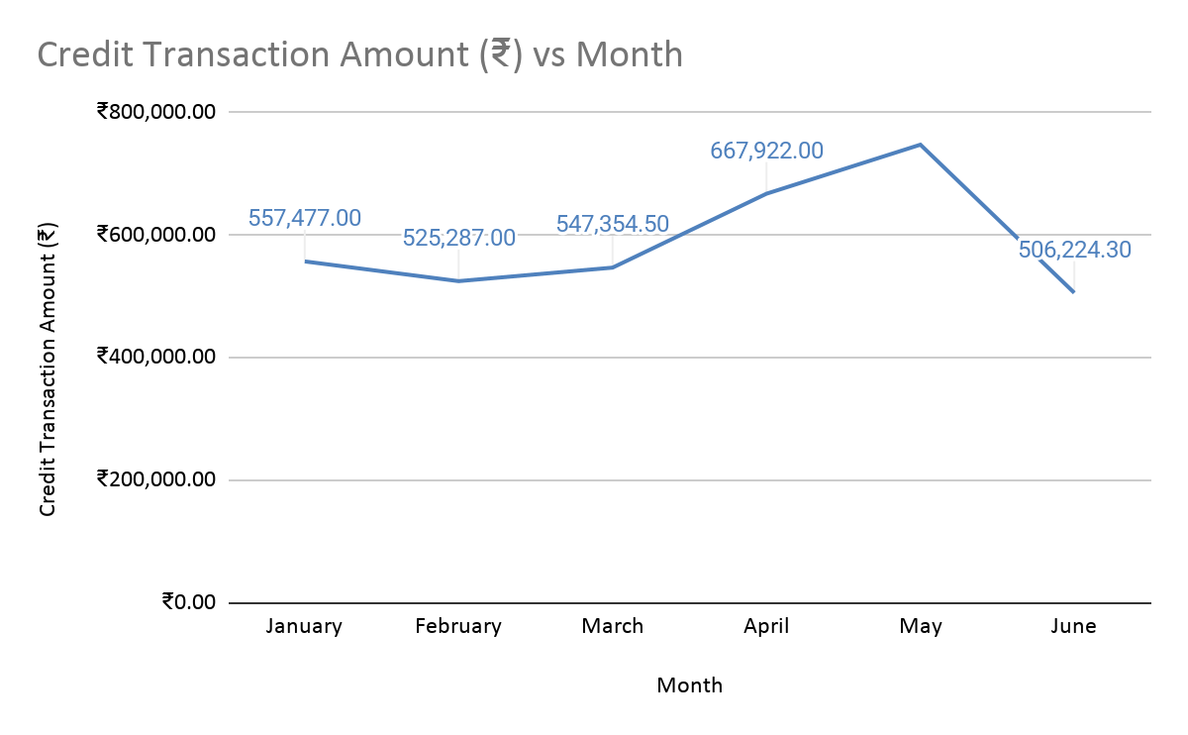
FINANCIAL & WORKING CAPITAL CONTEXT
Monthly Credit Transaction Value (Jan-Jun ‘26)
CREDIT ACTIVITY
₹5.92 lakh
Average monthly value
₹7.48 lakh
May - highest recorded value
16.04%
Coefficient of variation
Credit activity was comparatively stable, but varied across months. May recorded the highest credit transaction value. The available data do not establish whether the May peak reflects service-order volume, billing timing, or cash-collection cycles.
Use credit activity as supporting financial context, not as a direct procurement or revenue indicator.

Slide 9
RECOMMENDED ACTION PLAN
01| INVENTORY & PROCUREMENT
CAPITAL & PROCUREMENT CONTROL
Review A-class inventory frequently
Review procurement monthly using inventory needs + ABC
Future: Add consumption/stock velocity to ABC analysis
Future: Introduce reorder points & safety stock using demand and lead-time data
02 | WORKFORCE & SERVICE
WORKFORCE & SERVICE RELIABILITY
Maintain backup personnel for critical service requirements
Reduce repeat visits through better diagnosis, parts preparation & allocation
Categorise complaints by service type & machine model
Align technician skills with service requirements and geographic routes
EXPECTED BUSINESS VALUE
Tighter inventory control + more reliable service execution
Lower operational risk and better working-capital discipline

Slide 10
THANK YOU
BDM Project link: Click here

